Slide 1
ReactJS
Components

Slide 2

Contents page
What are Components?
How do we know when to create them?
Examples of Component use

Slide 3
Course objectives
Describe what a Component is and why we use them
Discuss how we go about splitting a UI into Components
Create an example of Component use

Slide 4
What is a Component?
Components are used to split a section of UI into a piece that is:
Independent
Re-usable
Takes data from our application and returns a series of react elements describing what should appear on the screen.
Reacts entire design philosophy is about creating components, to then bring them together to create a website!

Slide 5
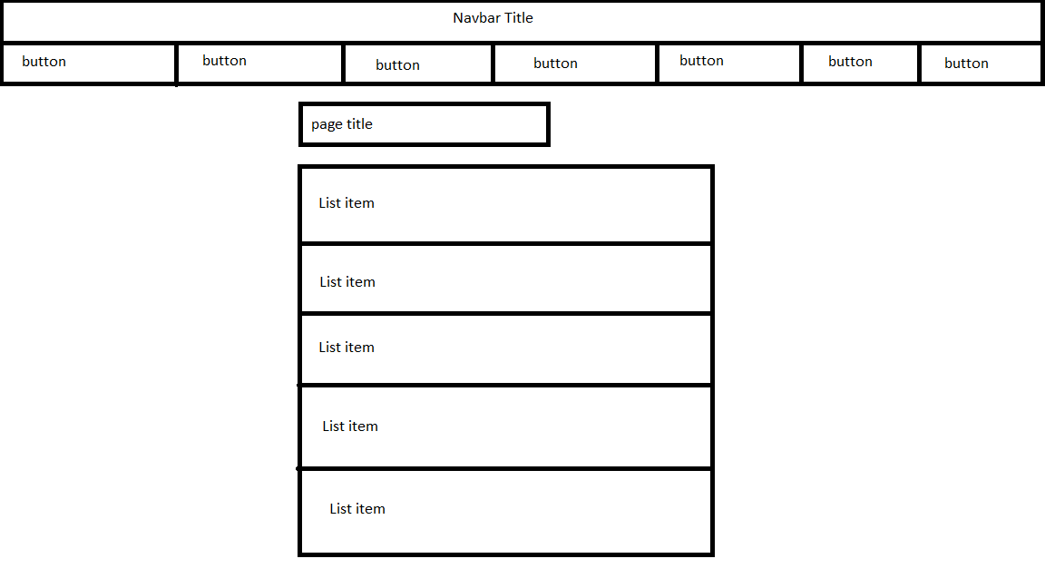
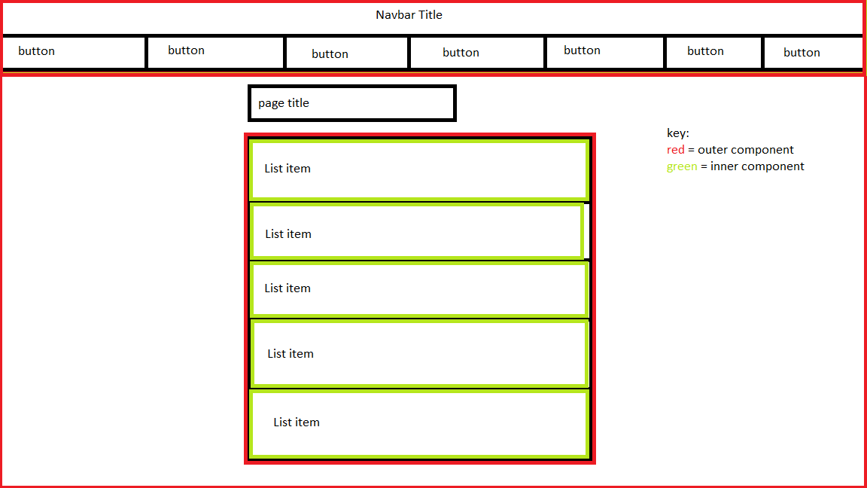
Splitting a page into Components
There are many ways to split a design into components. This is primarily down to personal preference and there is no right answer
Here the navbar is its own component, as is the page contents
Here the list is also made up of two components, a container and list item, this is so the list items can be repeated to create as many as will be needed

Slide 6

Thinking in React

Slide 7
Practice activities
Activity:
For the design on the previous slide, discuss other ways in which you could split this into components
Make notes or a quick diagram on how you may do this
Debrief:
Share your ideas with the class and decide which may be the best solution to use
Notes:
Trainer note – if not already, discuss the idea of passing props into the list item components on the previous page to get them to render something different, ask delegates to think what this would look like.

Slide 8
Thinking in React

Slide 9
How do we create a Component?
There are 2 main methods of creating a component, the first is to declare the component as a class
When declaring a component as a class it must:
Extend the Component class within the react library
Implement the render function which specifies which elements to place on the page, a component can only have one render function.
Class declarations can include functions to enhance functionality

Slide 10
Class Component declaration example
import React, { Component } from 'react';
export class SubComponentClassMethod extends Component {
render() {
return (
<table>
<tr>
<th>heading 1</th>
<th>heading 2</th>
<th>heading 3</th>
</tr>
<tr>
<td>value 1</td>
<td>value 2</td>
<td>value 3</td>
</tr>
</table>
)
}
}
Here we declare a component as a class
Note that the new class extends the Component class from the React library
We can see from the render function that this Component will display a table on the screen

Slide 11
How do we create a Component? Pt.2
The second method of declaring a component is via a function
When declaring a component as a function it must:
Have a single argument called props
Return JSX elements
Function declarations are ideal for components which do not need much, if any logic, they are shorter, more concise, and therefore more clearly readable

Slide 12
Function Component declaration example
import React from 'react';
export function SubComponentFunctionMethod(props) {
return (
<table>
<tr>
<th>heading 1</th>
<th>heading 2</th>
<th>heading 3</th>
</tr>
<tr>
<td>value 1</td>
<td>value 2</td>
<td>value 3</td>
</tr>
</table>
)
}
Here we declare a component as a function
Note that we do not need to import the Component class here
We can see that the function takes in the required argument of props, and returns JSX elements forming the same table as the class declaration example
Notes:
Expect a question about props here

Slide 13
How do we use a declared component?
import React, { Component } from 'react';
import { SubComponentClassMethod } from './components/SubComponentClassMethod';
class App extends Component {
render() {
return (
<div className="App">
<div>
Class method component declaration:
<SubComponentClassMethod />
</div>
</div>
);
}
}
export default App;
There are two very simple steps to using a component we have declared, importing the component into the document we wish to use it in, and placing the name of the component in JSX tags

Slide 14
Practice activities
Activity:
Create two components, using both methods of declaring a component and have these display on the screen
Try to have these imitate the design from earlier, with a navbar, and page contents
Debrief:
Work with the person next to you to ensure you both understand the process you undertook

Slide 15
Best Practices
Component names should always begin with a Capital letter.
React.Component is an abstract class in the React Package
You then inherit from this class to create your own components.
For each component you make, put it into a .js file named the same as the component, Capital Letter.

Slide 16
Thank you for listening
Any Questions?

